Slide 1
Big Mountain Resort
Analyzing possible solutions and strategies to help Big Mountain Resort maximize profits

Slide 2
Problem Identification
How can Big Mountain Resort increase revenue to support operational costs by either making changes to keep the same ticket price or increase ticket prices by the start of the season?
Based on the data given, we would need a model that provided the best recommendations for setting ticket prices that would generate profit from facility usage.

Slide 3
Recommendations
Based on our findings from the given data

Slide 4
Recommendations
Increase the daily weekend price up tp $98
If necessary, close no more than 5 of the least used runs
Add an additional run, increase the vertical drop by 150 ft, add another chair lift and add 2 acres of snow making

Slide 5
Models and Analysis

Slide 6
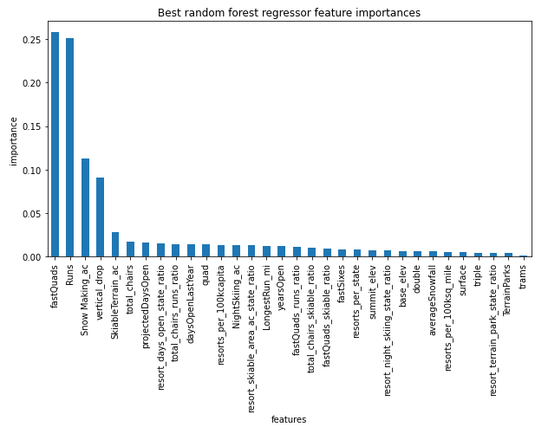
Modeling Results: Random Forest Generator
After viewing several models, a random forest was the most accurate. This model determined that the four most important features when predicting price are:
Fast quad lifts
Total amount of runs
Acres of Snow-Making
Vertical drops

Slide 7
Modeling Results and Analysis
Based off the four features, our models concluded that:
Adding an additional two acres of snow making area would support an estimated ticket price rise of $1.99 for an additional revenue of $34,746.38 per season
Adding an additional run and increasing the vertical drop by 150 feet and installing an additional chair lift is estimated to support a 41.55 increase in ticket price, resulting an an additional revenue of $27,083.33 per season.

Slide 8
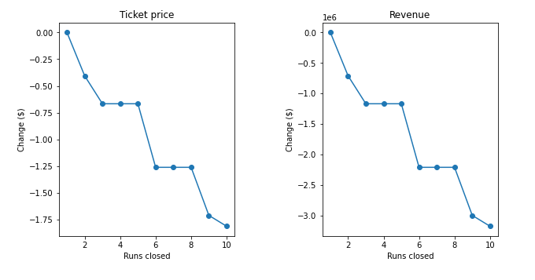
Modeling Results: A look at closing runs
With the total amount of runs being another key feature, one scenario that was suggested was closing up to 10 of the lease used runs on the mountain.
Based on the model, closing one run makes no difference. Closing 2 and 3 successively reduces support for ticket price and so revenue. If Big Mountain closes down 3 runs, it seems they may as well close down 4 or 5 as there's no further loss in ticket price. Increasing the closures down to 6 or more leads to a large drop.

Slide 9
Conclusion

Slide 10
Summary and Conclusion
While Big Mountain is an above average ski resort in the US, it is currently not making the most out of its facilities and therefore will need to make some changes in order to maximize its profits. The following suggestions are:
If necessary, close no more than 5 of the least used runs
Add 2 acres of snow-making area
Increase ticket price by $1.99 after adding an additional run, increasing the vertical drop by 150 ft, and adding another chair lift

